Slide 1
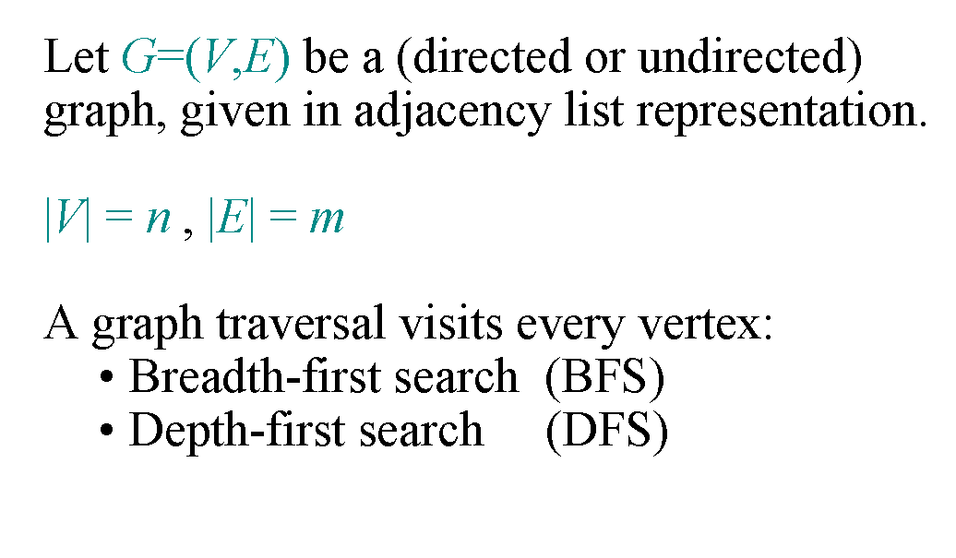
Graph Traversal

Slide 2
Breadth-First Search
Associate vertex “colors” to guide the algorithm
  White vertices have not been discovered
    All vertices start out white
  Green vertices are discovered but not fully explored
    They may be adjacent to white vertices
  Black vertices are discovered and fully explored
    They are adjacent only to black and gray vertices
Explore vertices by scanning adjacency list of grey vertices

Slide 3
Breadth-First Search
BFS(Graph G, vertex Start) {
initialize vertices; // mark all vertices as white
Create tree T using all vertices from G
Q = {Start}; // Q is a queue; insert vertex u
while (Q not empty) {
u = Dequeue(Q);
for each v ∈ u->adjacent {
if (v->color == WHITE) {
v->color = GREEN;
Enqueue(Q, v);
tree T add vertex v and edge(u,v);
}
}
u->color = BLACK;
}
}

Slide 4
Breadth-First Search: Example
r
s
t
u
∞
∞
∞
∞
∞
∞
∞
∞
v
w
x
y

Slide 5
Breadth-First Search: Example
r
s
t
u
∞
0
∞
∞
∞
∞
∞
∞
v
w
x
y
Q:
s

Slide 6
Breadth-First Search: Example
r
s
t
u
1
0
∞
∞
∞
1
∞
∞
v
w
x
y
Q:
w
r

Slide 7
Breadth-First Search: Example
r
s
t
u
1
0
2
∞
∞
1
2
∞
v
w
x
y
Q:
r
t
x

Slide 8
Breadth-First Search: Example
r
s
t
u
1
0
2
∞
2
1
2
∞
v
w
x
y
Q:
t
x
v

Slide 9
Breadth-First Search: Example
r
s
t
u
1
0
2
3
2
1
2
∞
v
w
x
y
Q:
x
v
u

Slide 10
Breadth-First Search: Example
r
s
t
u
1
0
2
3
2
1
2
3
v
w
x
y
Q:
v
u
y

Slide 11
Breadth-First Search: Example
r
s
t
u
1
0
2
3
2
1
2
3
v
w
x
y
Q:
u
y

Slide 12
Breadth-First Search: Example
r
s
t
u
1
0
2
3
2
1
2
3
v
w
x
y
Q:
y

Slide 13
Breadth-First Search: Example
r
s
t
u
1
0
2
3
2
1
2
3
v
w
x
y
Q:
Ø

Slide 14

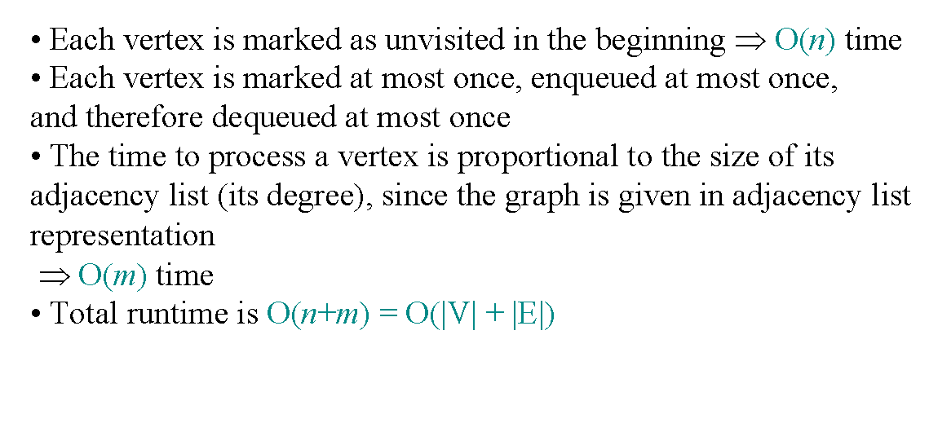
BFS Runtime

Slide 15
Depth First Search
DFS(Graph G, Vertex v)
  mark all vertices as “unvisited”
  for each vertex v do
    if v is unvisited
      set v as visited
      return DFS_rec(tree, v)
DFS_rec( tree, v)
  for each vertex w adjacent to v do
    if w is unvisited
      add edge (v,w) to tree
      set w as visited
      DFS_rec( tree, w) //recursive call
  return tree

Slide 16
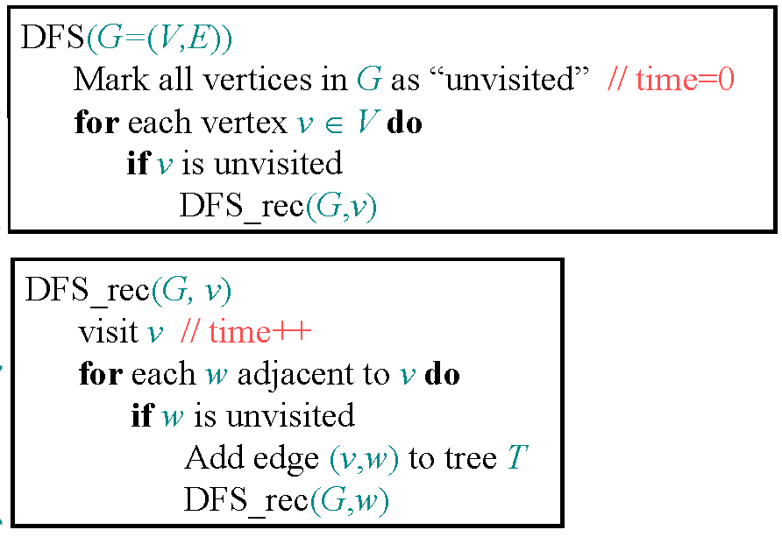
Depth First Search

Slide 17
DFS Stack
// prints all not yet visited vertices reachable from s
DFS(int s) {
Initially mark all vertices as not visited
Stack stack // Create a stack for DFS
stack push s // Push the current source node.
while stack not empty {
  s = stack.pop()// Pop a vertex from stack
  //print the popped item only if it is not visited.
  if (!visited[s])
  {
  Print node
  set visited as true;
  }
for each vertex w popped vertex s
If not visited, push onto the stack.
}
}

Slide 18
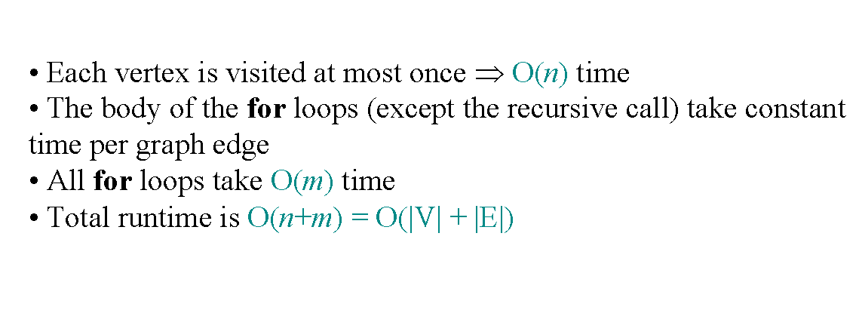
DFS runtime

Slide 19
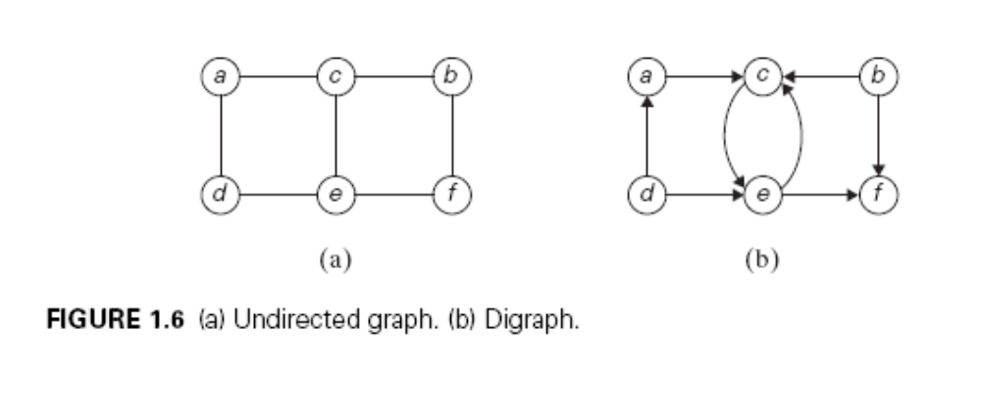
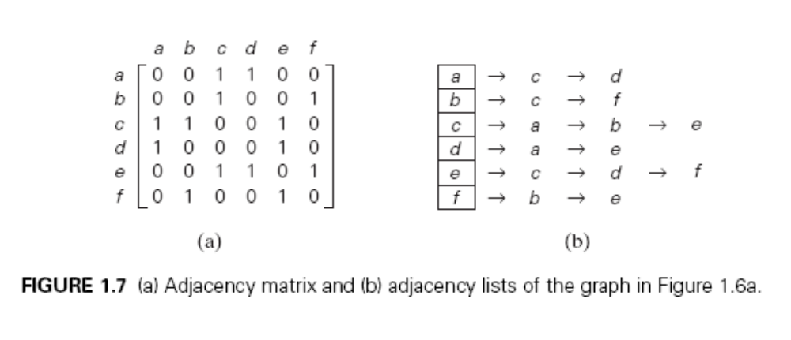
Adjacency Matrix

Slide 20
Adjacency List

Slide 21
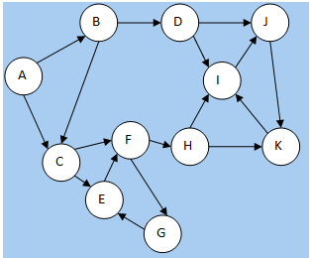
Traversal BFS and DFS
Connected
Sparse/Dense
Degree in/out
Strongly Connected
  Graph
  Components
BFS Trees
  Start A
  Start C
DFS Trees
  Start A
  Start B
Notes:
Connected - Yes
Sparse/Dense 11 vertices and 17 edges. 17 is far less than 121 (11*11) therefore sparse
Degree in/out A in 0, A out 2; B in 1, out 2; C in 2, out 2;…
Strongly Connected
Graph - Not strongly connected.
Components – I, J, K are strongly connected or a strongly connected component. (cycle of edges) Also E, G, and F
BFS Trees
Start A: A->B, A->C, B->D (not B->C as C already found), C-> E, C->F, D->J, D->I, E->none, F->G, F->H, J->K, I->none, G->none, H->I, K->none, done. (many BFS searches of this graph)
Start C: C-> F, C->E, F->H, F->G, H-> I, H-> K, G to none, I-> J, unable to reach more of graph
DFS Trees
Start A: A->B, B->D, D->J, J->K, K->I, I->none, backtrack to K none, backtrack to J none, backtrack to D (I already found), backtrack to B B->C, C->F, F->H, H none (I and K already found), backtrack to F F-G, G->E, (all are found) but will backtrack and look for missing nodes at G, F, C, B, and then A.
Start B: B-> C, C->E, E-> F, F->G backtrack to F, F-> H, H->K, K->I, I-> J, backtrack I, K, H, F, G, E, C, B, and then B->D. (Many valid DFS searches of this graph)

